Slide 1
SolutionPack for Brocade Watch4net Official Content v 1.1
2013-02-18 -- A.Lemay – Initial version
2013-02-21 -- A.Lemay – Text fix

Slide 2
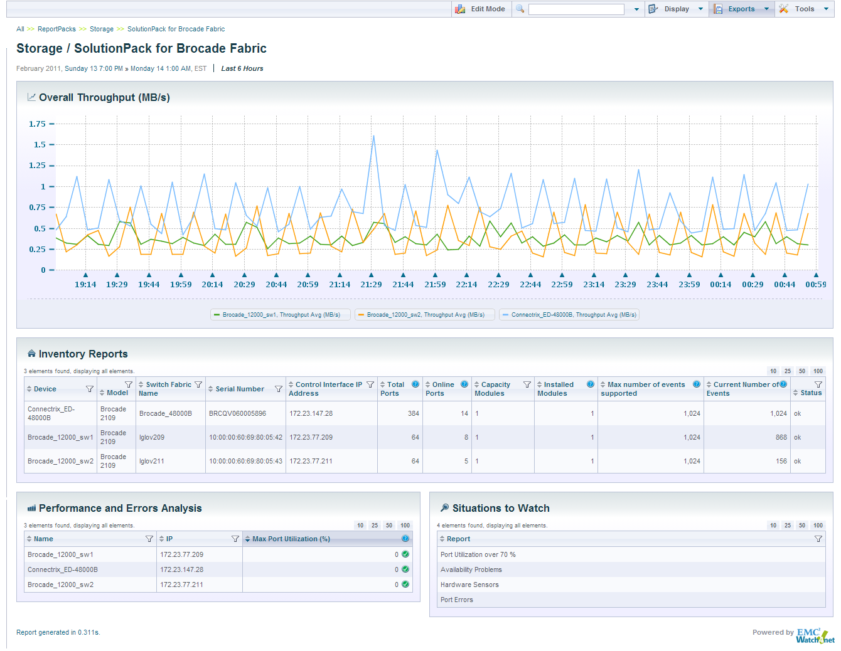
Main Live Dashboard
Brocade device drill-down
Complex analysis to help you be proactive

Slide 3
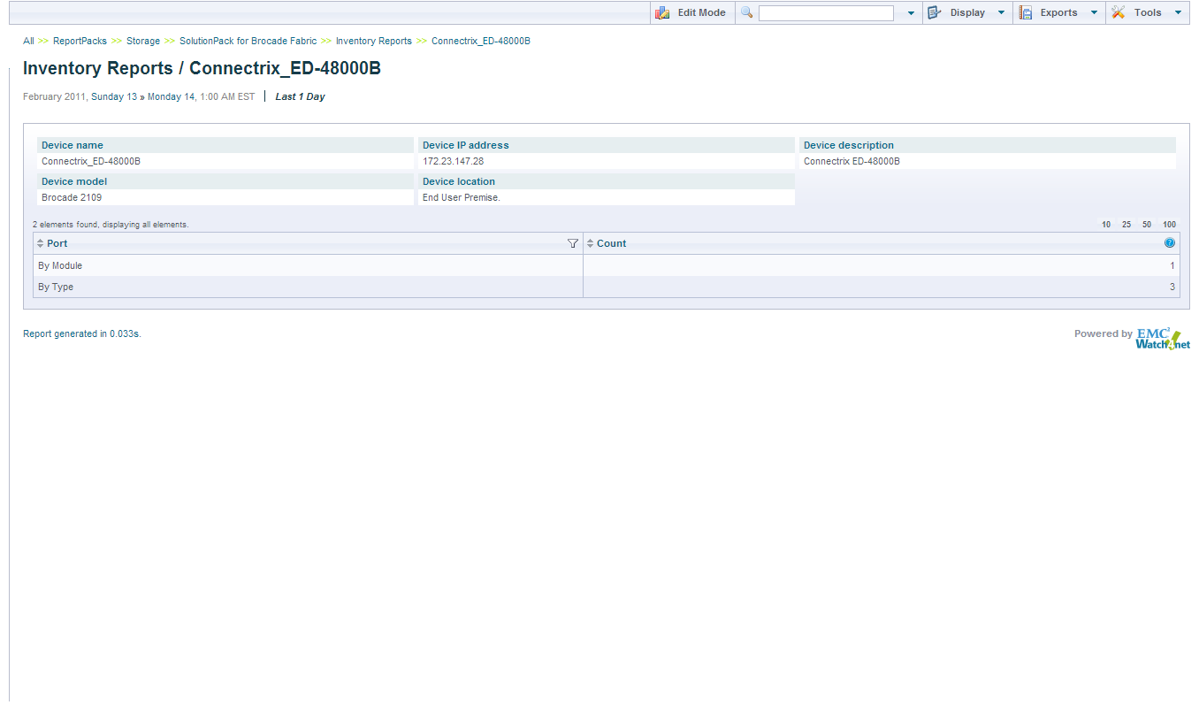
Drill-down detailed inventory

Slide 4
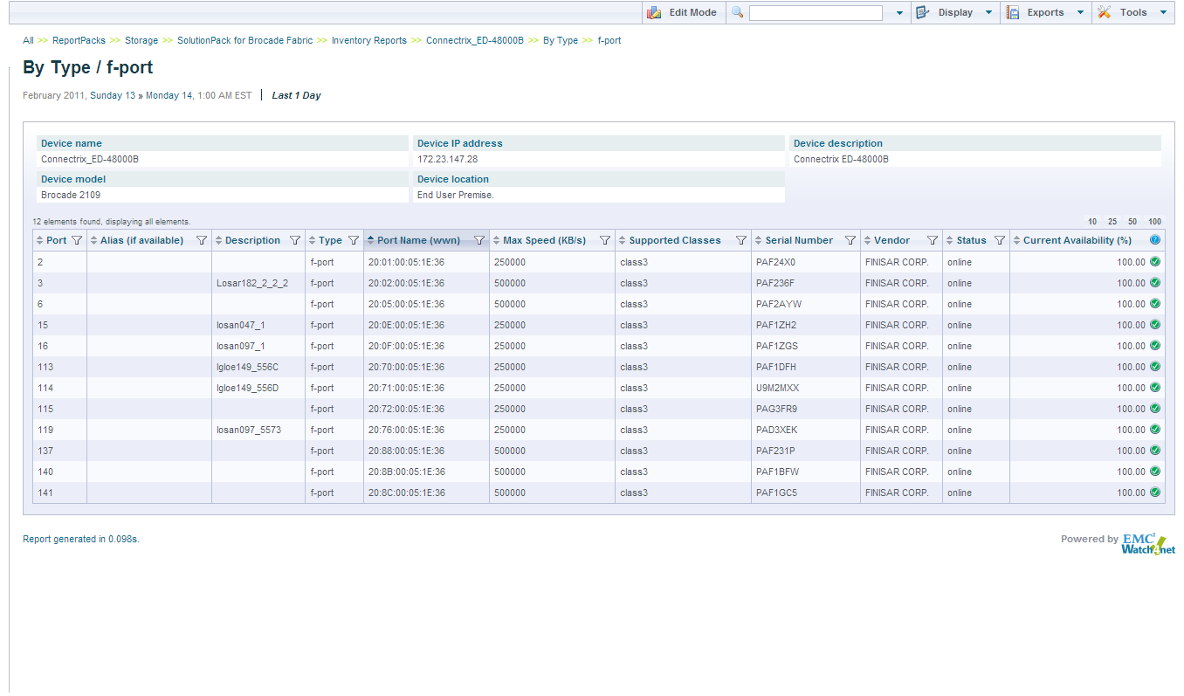
Real-time & Historical Availability Reporting
Port Status & Availability

